Slide 1
Adam: A Method for Stochastic Optimization
Daniil Sherki
Egor Cherepanov
Optimization methods, 2023

Slide 2
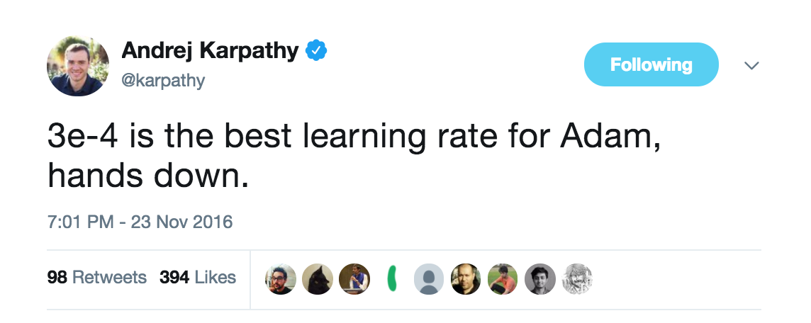
Introduction
Adam can be looked at as a combination of RMSprop and Stochastic Gradient Descent with momentum. It uses the squared gradients to scale the learning rate like RMSprop and it takes advantage of momentum by using moving average of the gradient instead of gradient itself like SGD with momentum. Let’s take a closer look at how it works.
+
Adagrad
RMSProp
works well with sparse gradients
works well in on-line and non-stationary settings
Adam
Adam’s advantages:
the magnitudes of parameter updates are invariant to rescaling of the gradient;
stepsizes are approximately bounded by the stepsize hyperparameter;
does not require a stationary objective;
works with sparse gradients;
naturally performs a form of step size annealing.

Slide 3
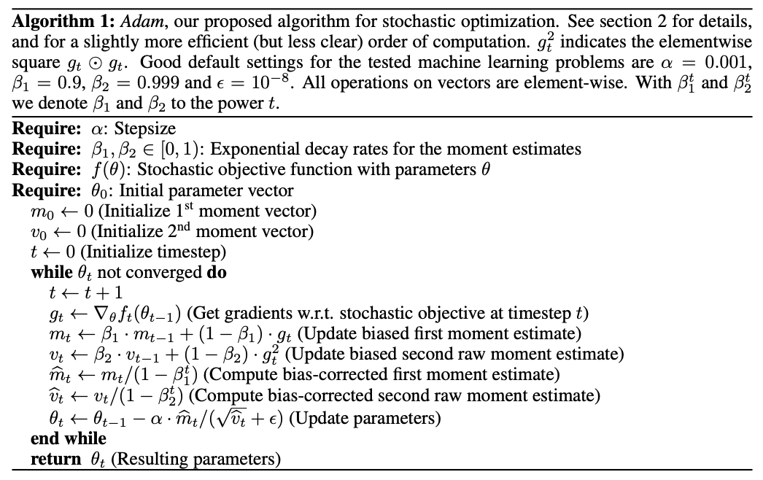

Slide 4
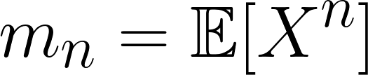
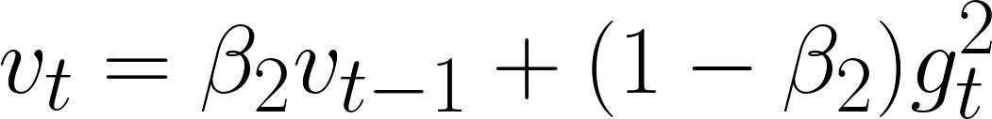
Adam’s update rule. Part 1
N-th moment of a random variable is defined as the expected value of that variable to the power of n.
Adam is an adaptive learning rate method, which means, it computes individual learning rates for different parameters. Its name is derived from adaptive moment estimation.
The first moment is mean, and the second moment is uncentered variance.
m and v are moving averages, g is gradient on current mini-batch, and betas — new introduced hyper-parameters of the algorithm.
Moving averages of gradient and squared gradient.

Slide 5
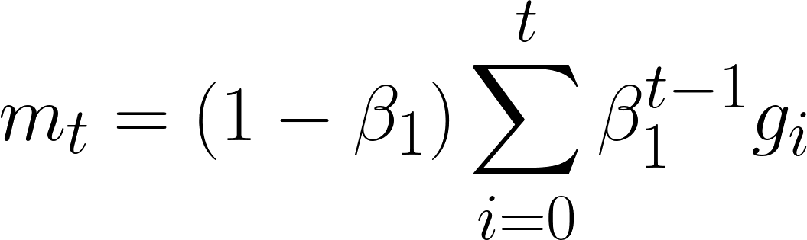
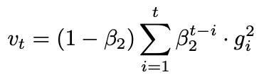
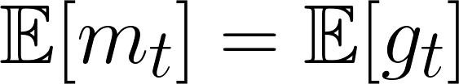
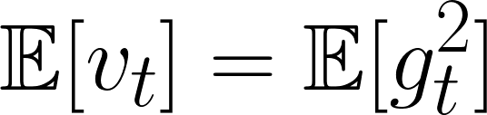
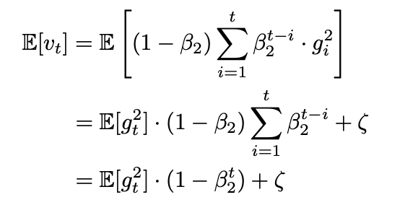
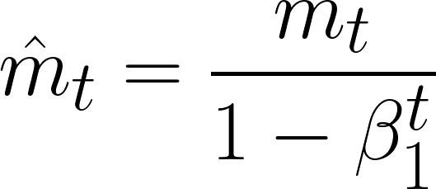
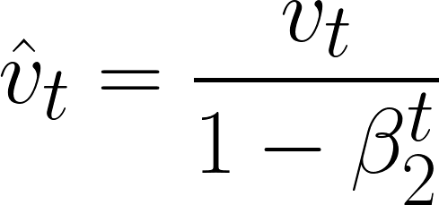
Adam’s update rule. Part 2
Since m and v are estimates of first and second moments, we want to have the following property:
Bias correction for the first momentum estimator
We can rewrite the formula for our moving average:
If these properties held true, that would mean, that we have unbiased estimators.
Do not hold true for the our moving averages =(
Correct the estimator:

Slide 6
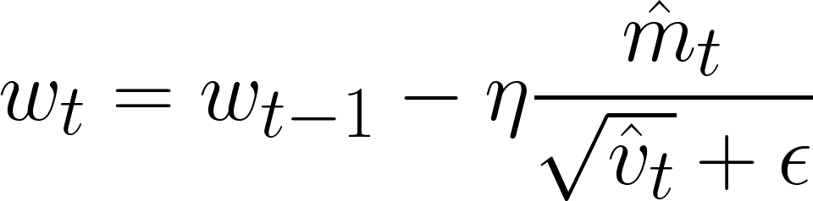
Final expression =)

Slide 7
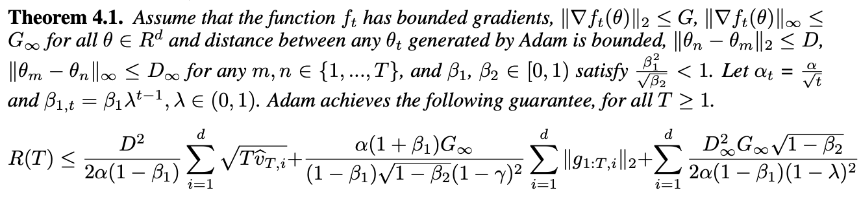


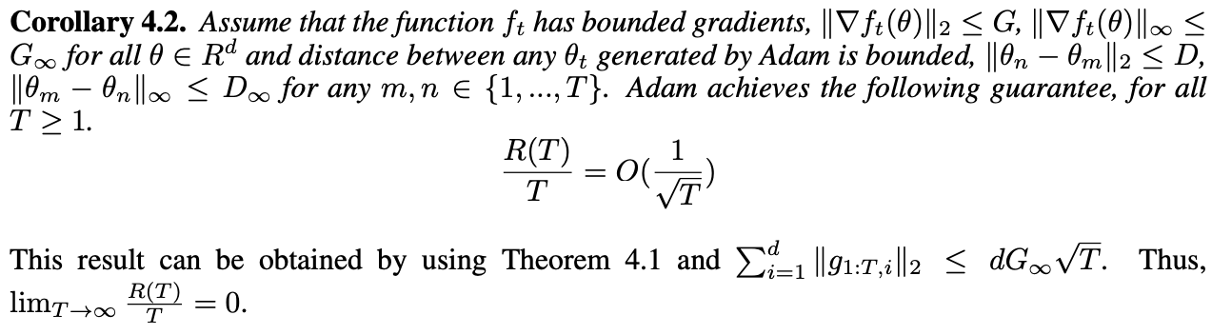
Convergence analysis
Adaptive
Non-adaptive

Slide 8
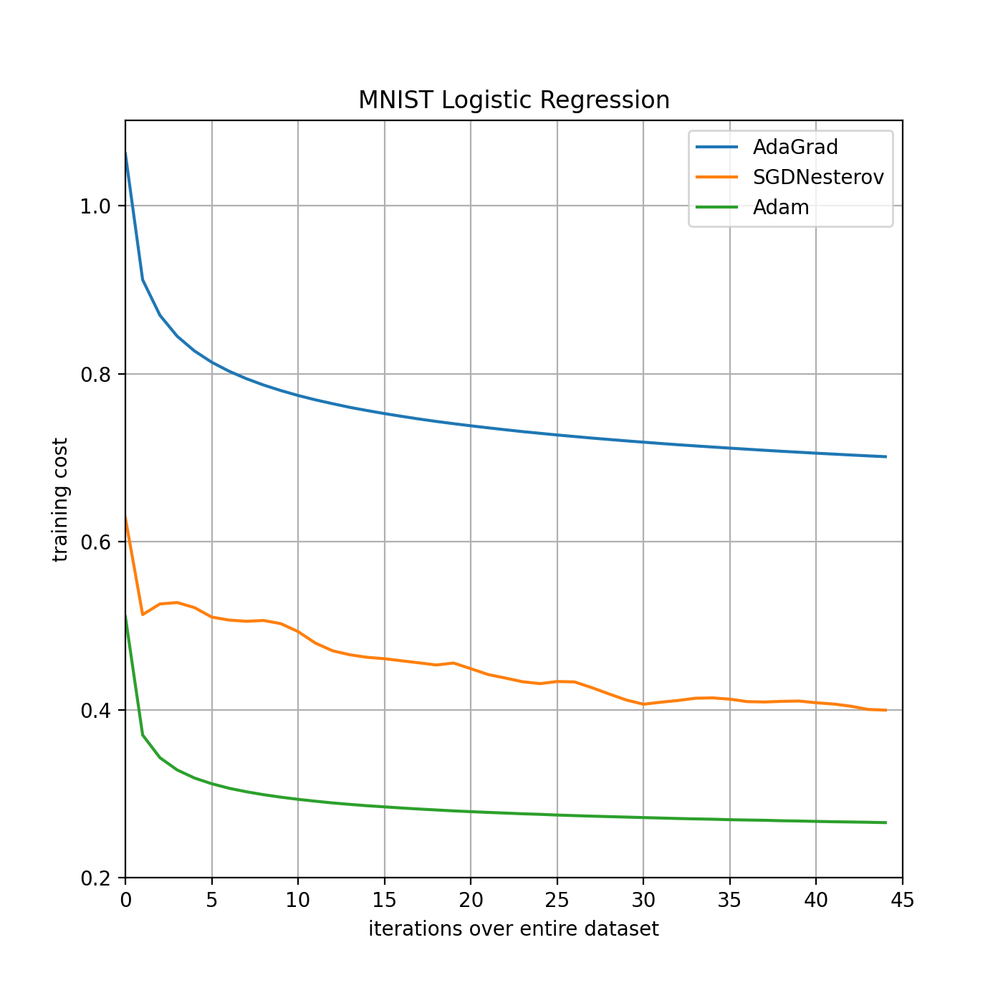
Experiments: Logistic Regression
Logistic regression has a well-studied convex objective, making it suitable for comparison of different optimizers without worrying about local minimum issues
The logistic regression classifies the class label directly on the 784 dimension image vectors
We found that the Adam yields similar convergence as SGD with momentum and both converge faster than Adagrad.

Slide 9
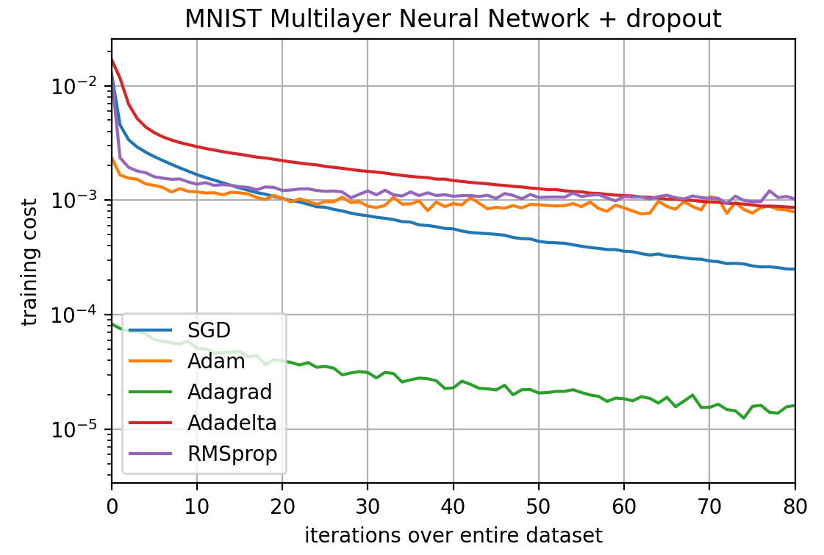
Experiments: Multi-layer Neural Networks
MNN architecture:
two fully connected hidden layers
1000 hidden units each layer
ReLU activation
mini-batch size 128
Results:
Empirically found that Adam often outperforms other methods in non-convex problems
There is no L2-regularization in loss function -> Adagrad with overfitting

Slide 10
Experiments: Convolutional Neural Networks
Unlike most fully connected neural nets, weight sharing in CNNs results in vastly different gradients in different layers
Our CNN architecture has three alternating stages with:
5x5 convolution filters
3x3 max pooling with stride of 2
that are followed by a fully connected layer of 1000 rectified linear hidden units (ReLU’s).
The minibatch size is also set to 128 similar to previous experiments.
We show the effectiveness of Adam in deep CNNs.

Slide 11
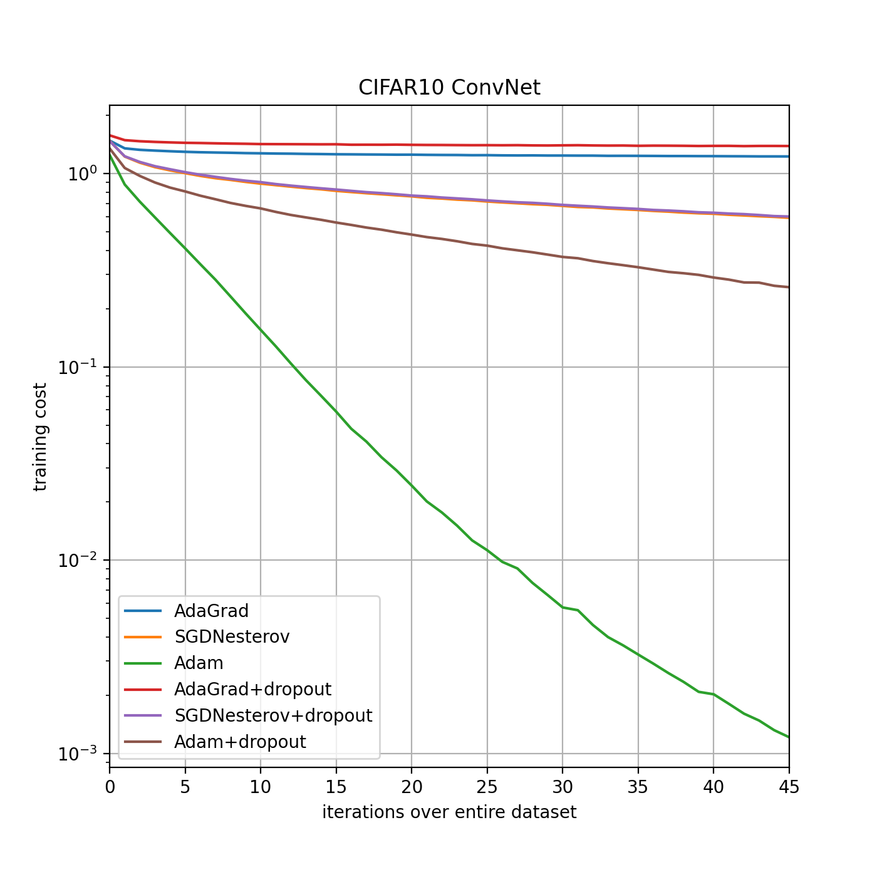
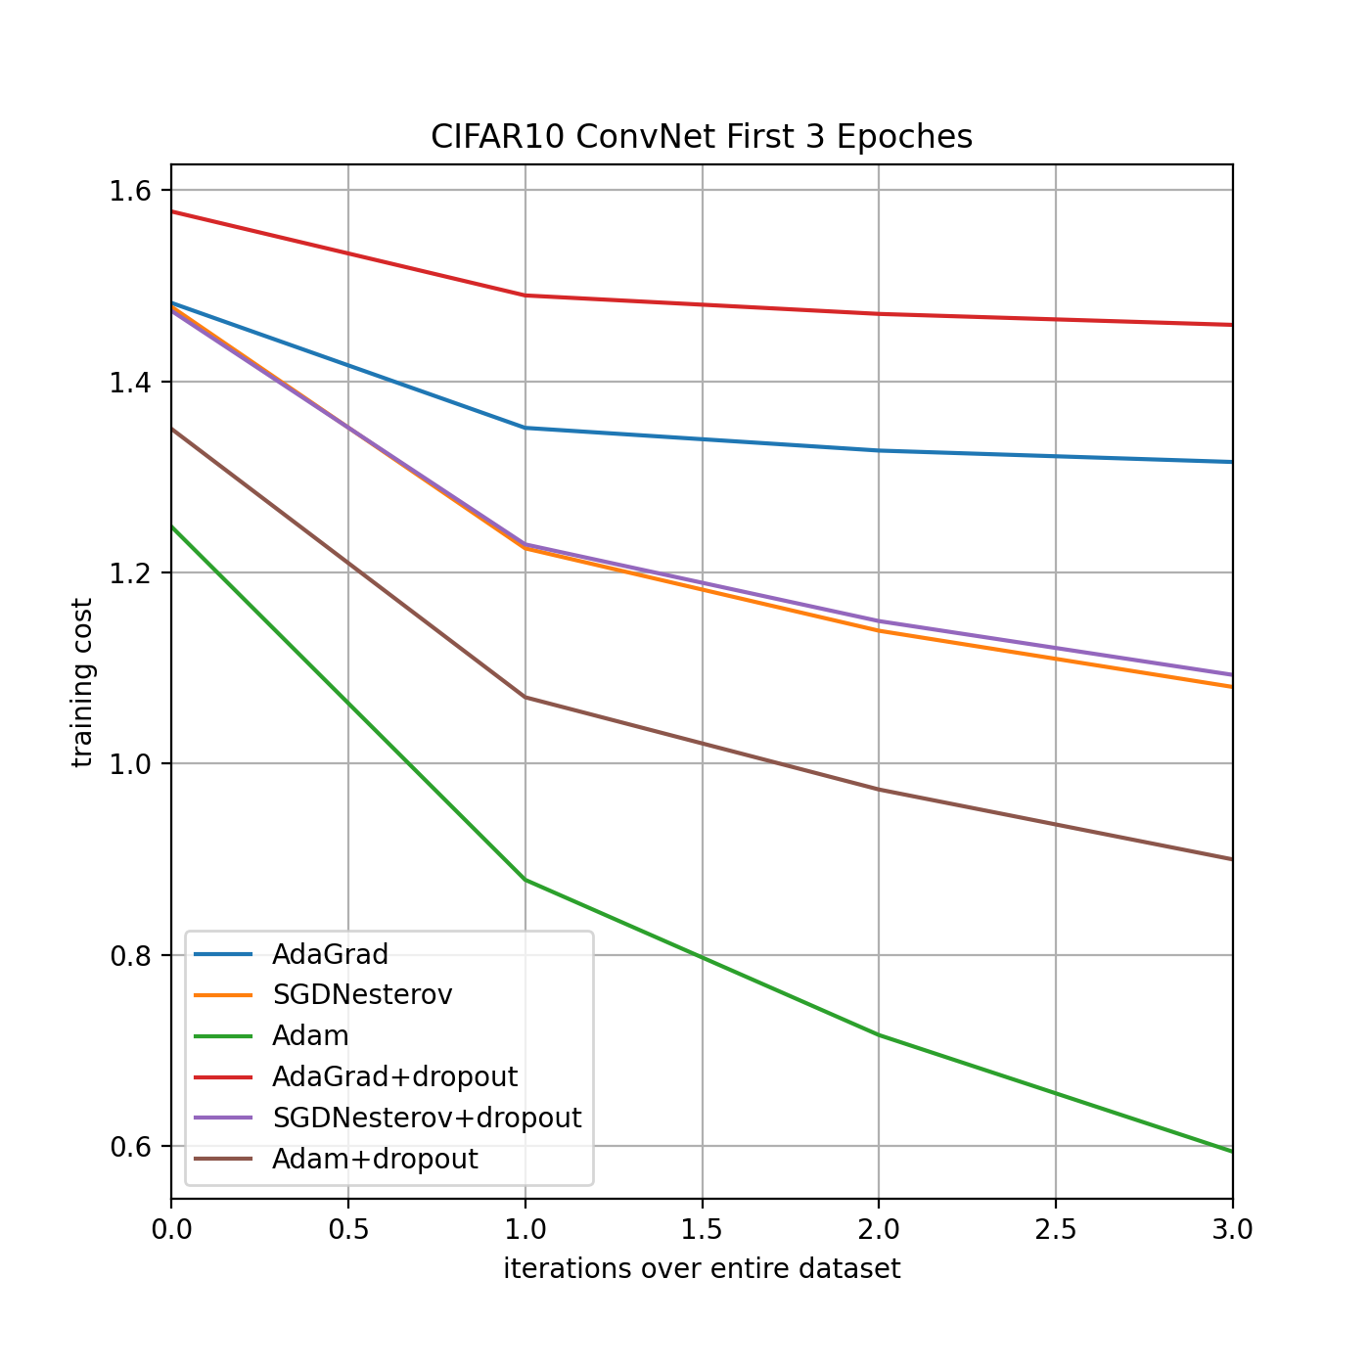
Experiments: Convolutional Neural Networks

Slide 12
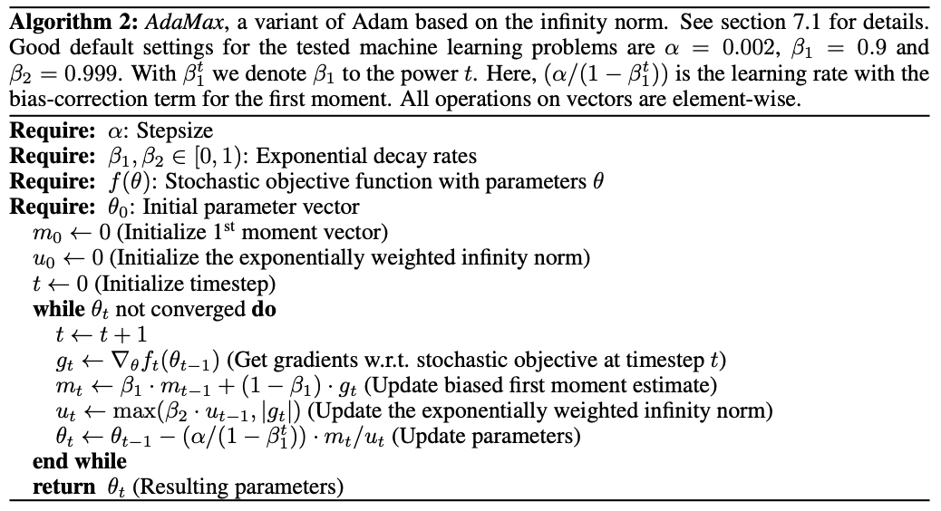
AdaMax

Slide 13
Conclusion
1. We have introduced a simple and computationally efficient algorithm for gradient-based optimization of stochastic objective functions.
2. Our method is aimed towards machine learning problems with large datasets and/or high-dimensional parameter spaces.
3. The method combines the advantages of two recently popular optimization methods: the ability of AdaGrad to deal with sparse gradients, and the ability of RMSProp to deal with non-stationary objectives.
4. The method is straightforward to implement and requires little memory.
5. Overall, we found Adam to be robust and well-suited to a wide range of non-convex optimization problems in the field machine learning.

Slide 14

GitHub repository

Slide 15
